Slide 1


Slide 2
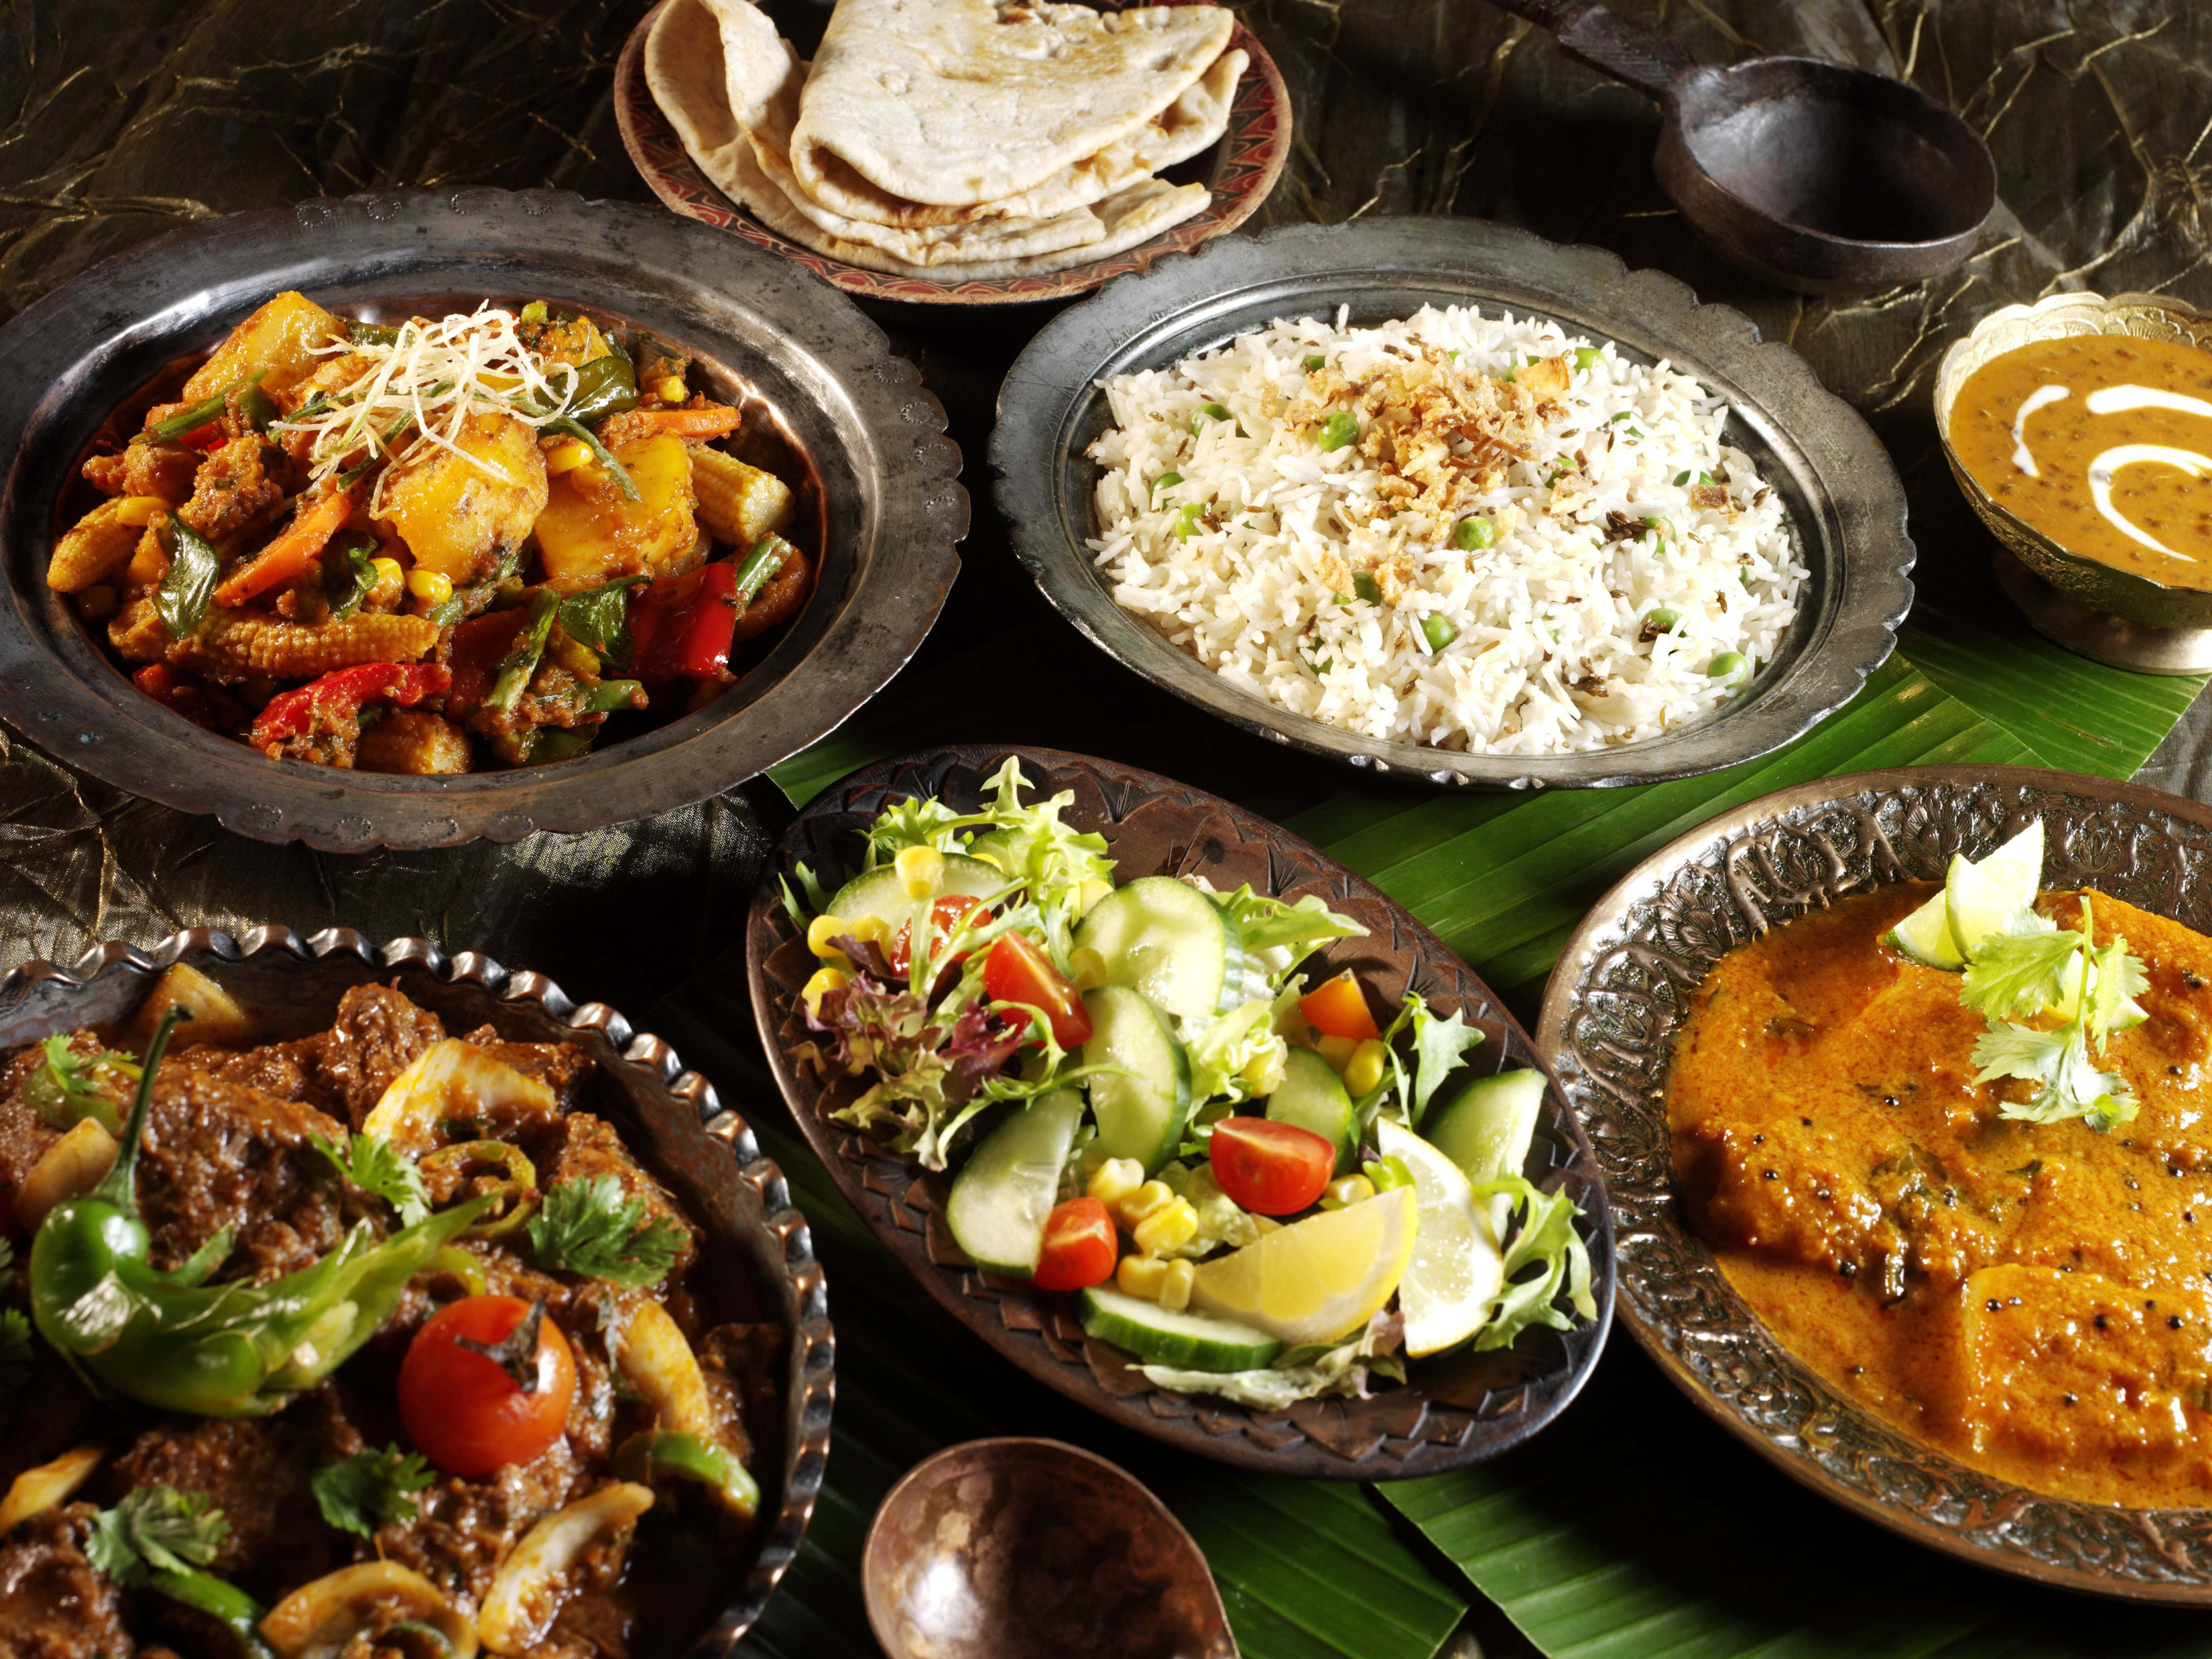
FAASOS is an online food ordering platform that offers a wide variety of cuisines and delivers to your doorstep.

Slide 3
Data Model Overview
Customer Orders Table
This table stores all the orders placed by customers, along with their details such as Order ID, Customer ID, Order date and time, Roll ID, Ingredients excluded, Extra Ingredient included
Delivery Details Table
This table stores the Order ID, Driver ID, Pickup Date and Time, Distance, Duration, and Cancellation Status
Ingredients Table
This table stores the details of all the Ingredient id and Ingredient Name
Driver Table
This table stores the details of all the delivery partners' Registration Dates, Delivery partner IDs
Rolls Table
This table stores the details of Rolls ID and Rolls Name
Rolls Recipe Table
This table stores the details of roll IDs and Ingredients used.

Slide 4
CUSTOMER ORDERS TABLE
order_id | customer_id | roll_id | not_include_items | extra_items_included | order_date
1 | 101 | 1 |  |  | 01-01-2021 18:05
2 | 101 | 1 |  |  | 01-01-2021 19:00
3 | 102 | 1 |  |  | 02-01-2021 23:51
3 | 102 | 2 |  | NaN | 02-01-2021 23:51
4 | 103 | 1 | 4 |  | 04-01-2021 13:23
4 | 103 | 1 | 4 |  | 04-01-2021 13:23
4 | 103 | 2 | 4 |  | 04-01-2021 13:23
5 | 104 | 1 | NULL | 1 | 08-01-2021 21:00
6 | 101 | 2 | NULL | NULL | 08-01-2021 21:03
7 | 105 | 2 | NULL | 1 | 08-01-2021 21:20
8 | 102 | 1 | NULL | NULL | 09-01-2021 23:54
9 | 103 | 1 | 4 | 1,5 | 10-01-2021 11:22
10 | 104 | 1 | NULL | NULL | 11-01-2021 18:34
10 | 104 | 1 | 2,6 | 1,4 | 11-01-2021 18:34

Slide 5
DELIVERY DETAILS TABLE
order_id | driver_id | pickup_time | distance | duration | cancellation
1 | 1 | 15:34.0 | 20km | 32 minutes
2 | 1 | 10:54.0 | 20km | 27 minutes
3 | 1 | 12:37.0 | 13.4km | 20 mins | NaN
4 | 2 | 53:03.0 | 23.4 | 40 | NaN
5 | 3 | 10:57.0 | 10 | 15 | NaN
6 | 3 | NULL | NULL | NULL | Cancellation
7 | 2 | 30:45.0 | 25km | 25mins | NULL
8 | 2 | 15:02.0 | 23.4 km | 15 minute | NULL
9 | 2 | NULL | NULL | NULL | Customer Cancellation
10 | 1 | 50:20.0 | 10km | 10minutes | NULL

Slide 6
Ingredients Table
ingredients_id | ingredients_name
1 | BBQ Chicken
2 | Chilli Sauce
3 | Chicken
4 | Cheese
5 | Kebab
6 | Mushrooms
7 | Onions
8 | Egg
9 | Peppers
10 | schezwan sauce
11 | Tomatoes
12 | Tomato Sauce

Slide 7
DRIVER TABLE
driver_id | reg_date
1 | 01-01-2021
2 | 03-01-2021
3 | 08-01-2021
4 | 15-01-2021
ROLLS TABLE
roll_id | roll_name
1 | Non Veg Roll
2 | Veg Roll
ROLLS RECIPES
TABLE
roll_id | ingredients
1 | 1,2,3,4,5,6,8,10
2 | 4,6,7,9,11,12

Slide 8
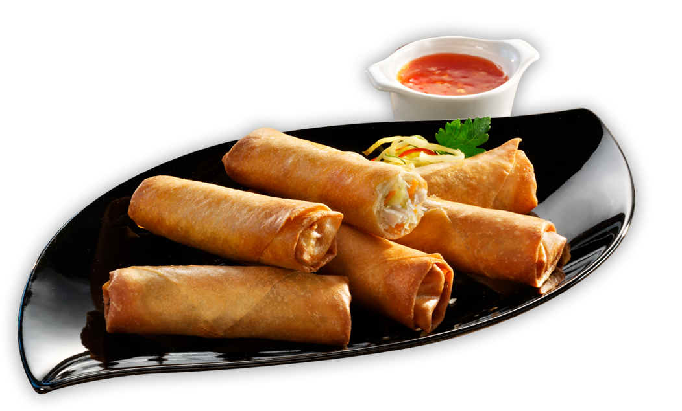
Rolls Metrics

Slide 9
How many total number of rolls were ordered by the customers?
SELECT COUNT (roll_id)Total_rolls_ordered FROM customer_orders
Output
Total_rolls_ordered
14

Slide 10
How many of each type of roll were delivered?
SELECT roll_id,COUNT(roll_id)cnt
FROM customer_orders WHERE order_id IN (SELECT order_id FROM
(SELECT *, CASE WHEN cancellation IN ('cancellation','customer cancellation') THEN 'c' ELSE 'nc' END AS order_cancel_details FROM driver_order) d
WHERE order_cancel_details = 'nc')
GROUP BY roll_id

Slide 11
Output
Roll_id | Cnt
1 | 9
2 | 3

Slide 12
SELECT a.customer_id, COUNT(b.roll_id)cnt,b.roll_name FROM customer_orders a INNER JOIN rolls b
ON a.roll_id = b.roll_id
GROUP BY customer_id,roll_name)
How many Veg and Non Veg Rolls are ordered by each customer?

Slide 13
customer_id | cnt | roll_name
101 | 2 | Non Veg Roll
102 | 2 | Non Veg Roll
103 | 3 | Non Veg Roll
104 | 3 | Non Veg Roll
101 | 1 | Veg Roll
102 | 1 | Veg Roll
103 | 1 | Veg Roll
105 | 1 | Veg Roll
Output

Slide 14
What was the maximum no of rolls delivered in a single order?
SELECT * FROM (SELECT *,RANK() OVER(ORDER BY cnt DESC)rnk FROM
(SELECT order_id, count(roll_id)cnt FROM
(SELECT * FROM customer_orders WHERE order_id IN
(SELECT order_id FROM
(SELECT *, CASE WHEN cancellation IN ('cancellation','customer cancellation') THEN 'c' ELSE 'nc'
END AS order_cancel_details FROM driver_order) d
WHERE order_cancel_details = 'nc'))e
GROUP BY order_id)f)g
WHERE rnk=1;

Slide 15
Output
Order_id | cnt | Rnk
4 | 3 | 1

Slide 16
What was the total number of rolls ordered for each hour of the day?
SELECT hrs_bucket,COUNT(hrs_bucket)Rolls_cnt FROM
(SELECT *,
CONCAT(CAST(DATEPART(hour,order_date)AS VARCHAR),'-',CAST(datepart(HOUR,order_date)+1 AS VARCHAR)) Hrs_Bucket FROM customer_orders)a
GROUP BY Hrs_Bucket

Slide 17
Output
hrs_bucket | Rolls_cnt
11-12 | 1
13-14 | 3
18-19 | 3
19-20 | 1
21-22 | 3
23-24 | 3

Slide 18
What was the total number of rolls ordered for each day of the week?
SELECT dow, COUNT(distinct order_id) rolls_cnt FROM
(SELECT *, DATENAME(dw,order_date)dow FROM customer_orders)a
GROUP BY dow

Slide 19
Output
dow | rolls_cnt
Friday | 5
Monday | 2
Saturday | 2
Sunday | 1

Slide 20
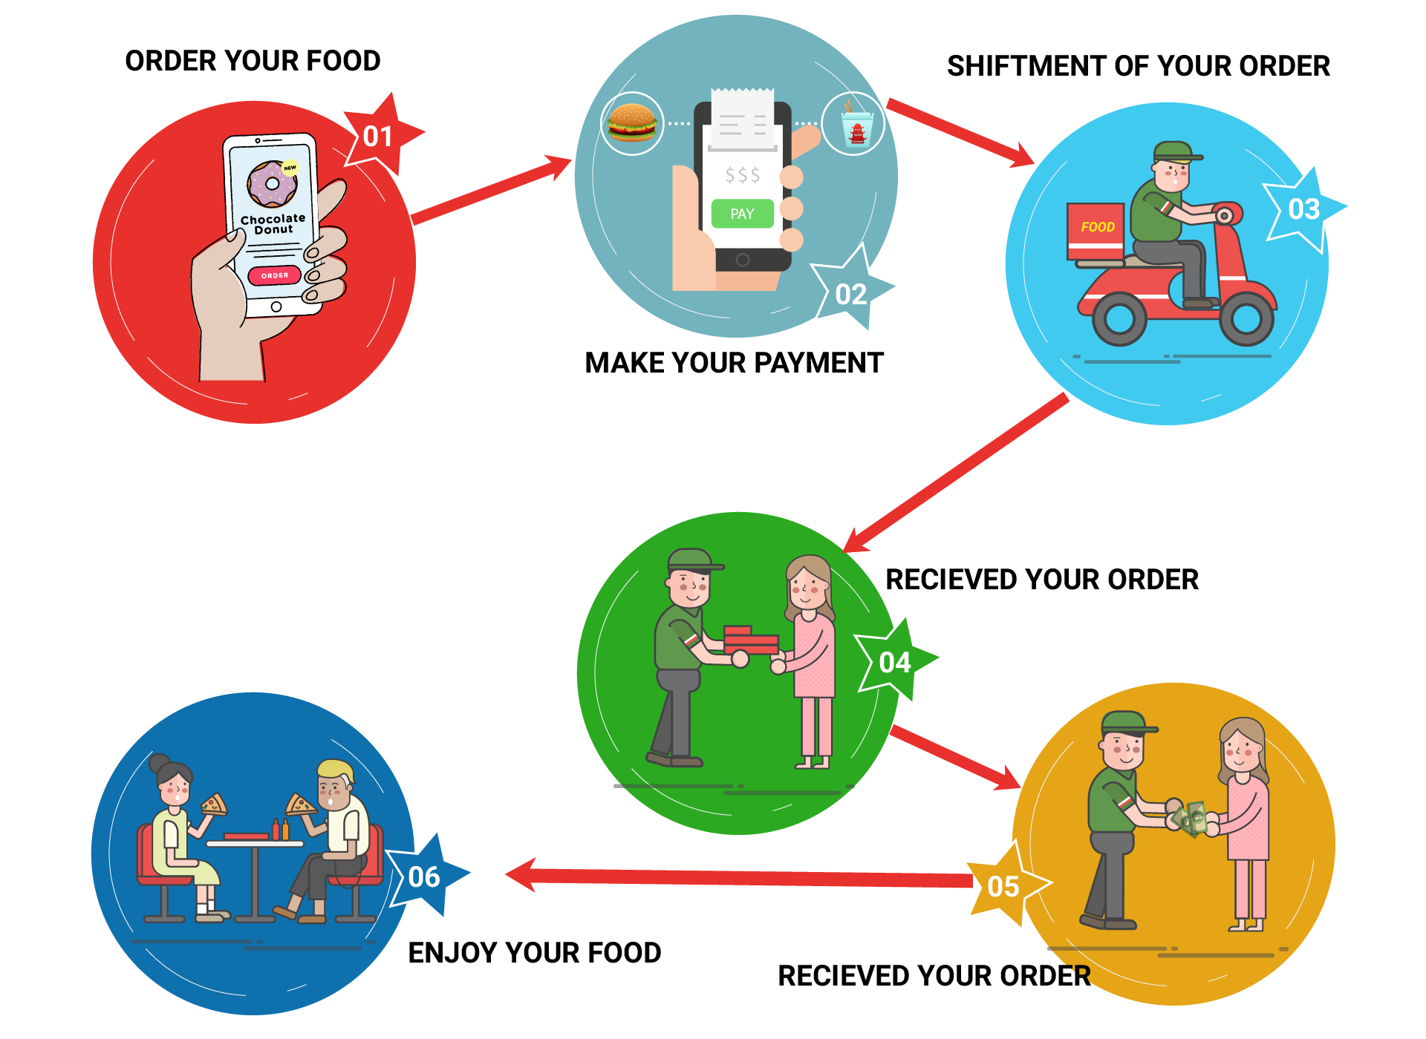
cUSTOMER & DELIVERY EXPERIENCE

Slide 21
SELECT COUNT (DISTINCT customer_id) Total_Cust FROM customer_orders;
How many customers orders were made?
Output
Total_Cust
5

Slide 22
How many successful orders were delivered by each Delivery Person?
SELECT driver_id, SUM(New_Cancellation)cnt FROM
(SELECT driver_id,CASE WHEN cancellation IN ('cancellation','customer cancellation') THEN 0 ELSE 1 end AS New_Cancellation
FROM driver_order)a
GROUP BY driver_id
Output
Driver_id​ | Cnt​
1​ | 4
2​ | 3
3​ | 1​

Slide 23
What was the average time in minutes to arrive at the Faasos Headquarters to pickup the order?
SELECT driver_id,SUM(diff)/COUNT(order_id)avgmins FROM
(SELECT * FROM
(SELECT *, ROW_NUMBER()OVER(PARTITION BY order_id order by diff )rnk FROM
(SELECT a.order_id,a.customer_id,a.roll_id,a.not_include_items,a.extra_items_included,a.order_date,
b.driver_id,b.pickup_time,b.distance,b.duration,b.cancellation, DATEDIFF(MINUTE,a.order_date,b.pickup_time)diff
FROM customer_orders a INNER JOIN driver_order b
ON a.order_id = b.order_id
WHERE b.pickup_time IS NOT NULL)a)b
WHERE rnk=1)c
GROUP BY driver_id

Slide 24
Output
driver_id | avgmins
1 | 14
2 | 20
3 | 10

Slide 25
Is there any relationship between the number of rolls and how long the order takes to prepare?
SELECT order_id,COUNT(roll_id)cnt,SUM(diff)/COUNT(roll_id)prepared_time FROM
(SELECT a.order_id,a.customer_id,a.roll_id,a.not_include_items,a.extra_items_included,a.order_date,
b.driver_id,b.pickup_time,b.distance,b.duration,b.cancellation, DATEDIFF(MINUTE,a.order_date,b.pickup_time)diff
FROM customer_orders a INNER JOIN driver_order b
ON a.order_id = b.order_id
WHERE b.pickup_time IS NOT NULL)c
GROUP BY order_id;

Slide 26
Output
order_id | Roll_cnt | Avg_prep_Time
1 | 1 | 10
2 | 1 | 10
3 | 2 | 21
4 | 3 | 30
5 | 1 | 10
7 | 1 | 10
8 | 1 | 21
10 | 2 | 16
Relationship: We can see the trend as the average time to prepare a roll is approximately 10 mins.

Slide 27
What was the average distance(in km) travelled for each customer?
SELECT customer_id, SUM(distance)/COUNT(order_id) cnt FROM
(SELECT * FROM
(SELECT *, ROW_NUMBER()OVER(PARTITION BY order_id ORDER BY diff )rnk FROM
(SELECT a.order_id,a.customer_id,a.roll_id,a.not_include_items,a.extra_items_included,a.order_date,
b.driver_id,b.pickup_time,
CAST(TRIM(REPLACE(LOWER(b.distance),'km','')) AS DECIMAL(4,2))distance,
b.duration,b.cancellation, DATEDIFF(MINUTE,a.order_date,b.pickup_time)diff
FROM customer_orders a INNER JOIN driver_order b
ON a.order_id = b.order_id
WHERE b.pickup_time IS NOT NULL)c)d
WHERE rnk=1)e
GROUP BY customer_id;

Slide 28
Output
Customer_id | Avg_distance
101 | 20.0000
102 | 18.4000
103 | 23.4000
104 | 10.0000
105 | 25.0000

Slide 29
What was the difference between the longest and shortest delivery times for all orders?
SELECT MAX(duration) - MIN(duration) diff FROM
(SELECT CAST(CASE WHEN duration LIKE '%min%' THEN LEFT(duration, CHARINDEX('m',duration)-1)ELSE
duration END AS integer)
AS duration
FROM driver_order
WHERE duration IS NOT NULL)a

Slide 30
Output
diff
30

Slide 31
What was the average speed for each driver for each delivery?
SELECT driver_id,order_id, a.Distance/a.Duration Avg_Speed from
(SELECT order_id, driver_id,
CAST(TRIM(REPLACE(LOWER(distance),'km','')) AS DECIMAL(4,2)) distance,
CAST(CASE WHEN duration LIKE '%min%' THEN LEFT(duration, CHARINDEX('m',duration)-1) ELSE duration END AS INTEGER)AS Duration
FROM driver_order
WHERE Distance IS NOT NULL)a
SELECT a.driver_id,a.order_id, a.Distance/a.Duration Speed,b.cnt FROM
(SELECT order_id, driver_id,
CAST(TRIM(REPLACE(LOWER(distance),'km','')) AS DECIMAL(4,2)) distance,
CAST(CASE WHEN duration LIKE '%min%' THEN LEFT(duration, CHARINDEX('m',duration)-1) ELSE duration END AS INTEGER)AS Duration
FROM driver_order
WHERE Distance IS NOT NULL)a
INNER JOIN
(SELECT order_id,count(roll_id)cnt FROM customer_orders
GROUP BY order_id)b
ON a.order_id = b.order_id;

Slide 32
Output
driver_id | order_id | Avg_Speed
1 | 1 | 0.625
1 | 2 | 0.740740741
1 | 3 | 0.67
2 | 4 | 0.585
3 | 5 | 0.666666667
2 | 7 | 1
2 | 8 | 1.56
1 | 10 | 1

Slide 33
What is the successful delivery percentage for each driver?
SELECT driver_id,(sucessfully_delivered*1.0/count_driver)*100 delivery_percent FROM
(SELECT driver_id, SUM(cancellation_per)sucessfully_delivered, COUNT(driver_id)count_driver FROM
(SELECT driver_id, CASE WHEN LOWER(cancellation) LIKE '%cancel%' THEN 0 ELSE 1 END AS cancellation_per FROM driver_order)a
GROUP BY driver_id)d;

Slide 34
Output
driver_id | delivery_percent
1 | 100.0000000
2 | 75.0000000
3 | 50.0000000

Slide 35
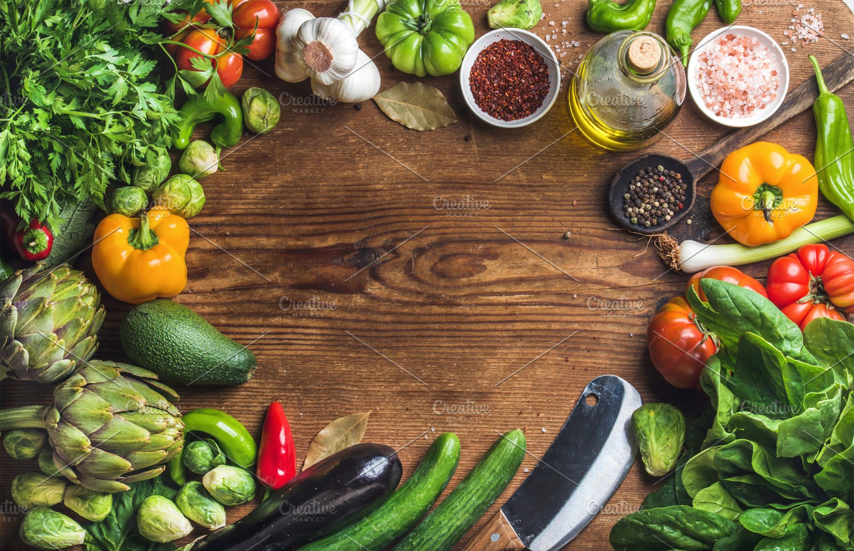
INGREDIENTS OPTIMISATION

Slide 36
How many rolls were delivered that had both extras ingredients and exclusions?
WITH
temp_customer_orders(order_id,customer_id,roll_id,not_include_items,extra_items_included,order_date) AS
( SELECT order_id, customer_id,roll_id, CASE WHEN not_include_items IS NULL OR not_include_items = ' ' THEN '0' ELSE not_include_items END AS New_not_include_items, CASE WHEN extra_items_included IS NULL OR extra_items_included = ' ' or extra_items_included= 'NaN' OR extra_items_included = 'Null' THEN '0' ELSE extra_items_included END AS New_extra_items_included, order_date
FROM customer_orders ) , temp_driver_order(order_id,driver_id,pickup_time,distance,duration,New_cancellation) AS ( SELECT order_id,driver_id, CASE WHEN pickup_time IS NULL THEN 0 ELSE pickup_time END AS New_pickup_time , CASE WHEN distance IS NULL THEN '0' ELSE distance END AS New_distance, CASE WHEN duration IS NULL THEN '0' ELSE duration END AS New_duration, CASE WHEN cancellation IS NULL OR cancellation = ' ' OR cancellation = 'NaN' THEN '0' ELSE '1' END AS New_cancellation FROM driver_order ) SELECT change_nochange,COUNT(Change_nochange)Both_Extra_Excl_items FROM (SELECT *, CASE WHEN not_include_items!='0' AND extra_items_included!='0' THEN 'Both inc Exc' ELSE 'Either 1 inc or exc' END AS change_nochange FROM temp_customer_orders WHERE order_id IN ( select order_id FROM temp_driver_order where New_cancellation=0))a GROUP BY change_nochange

Slide 37
Output
change_nochange | Both_Extra_Excl_items
Both inc Exc | 1
Either 1 inc or exc | 11

Slide 38
For each customer How many delivered rolls had at least 1 change and How many had no change in Ingredients?
WITH temp_customer_orders(order_id,customer_id,roll_id,not_include_items,extra_items_included,order_date) AS
(SELECT order_id, customer_id,roll_id,
CASE WHEN not_include_items IS NULL OR not_include_items = ' ' THEN '0' ELSE not_include_items END AS New_not_include_items,
CASE WHEN extra_items_included IS NULL OR extra_items_included = ' ' OR extra_items_included= 'NaN' OR extra_items_included = 'Null' THEN '0' else extra_items_included END AS New_extra_items_included,
order_date FROM customer_orders)
temp_driver_order(order_id,driver_id,pickup_time,distance,duration,New_cancellation) AS
( SELECT order_id,driver_id,
CASE WHEN pickup_time IS NULL THEN 0 ELSE pickup_time END AS New_pickup_time ,
CASE WHEN distance IS NULL THEN '0' ELSE distance END AS New_distance,
CASE WHEN duration IS NULL THEN '0' ELSE duration END AS New_duration,
CASE WHEN cancellation IS NULL OR cancellation = ' ' OR cancellation = 'NaN' THEN '0' ELSE '1' END AS New_cancellation
FROM driver_order )
SELECT a.customer_id,a.change_nochange, COUNT(a.order_id)Atleast_one_change FROM
(SELECT *, CASE WHEN not_include_items='0' AND extra_items_included='0' THEN 'No change' ELSE 'change' END AS change_nochange
FROM temp_customer_orders WHERE order_id IN (
SELECT order_id FROM temp_driver_order WHERE New_cancellation=0))a
group by customer_id,change_nochange;

Slide 39
Output
customer_id | change_nochange | Atleast_one_change
103 | change | 3
104 | change | 2
105 | change | 1
101 | No change | 2
102 | No change | 3
104 | No change | 1

Slide 40
Thanks for watching, PLEASE PROVIDE YOUR VALUABLE FEEDBACK OR SUGGESTION

